Slide 1

Navigation &
Architectural patterns
Lecture 9
Teacher:
Mahyar T. Moghaddam (mtmo@mmmi.sdu.dk)
Instructors:
Mikkel Nielsen (mini923@student.sdu.dk)
Asta Knudsen (asknu18@student.sdu.dk)

Slide 2
Agenda
Other architectures (MVC, MVP, MVI, MVVM, VIPER)
Navigation in Jetpack Compose
Project Work

Slide 3
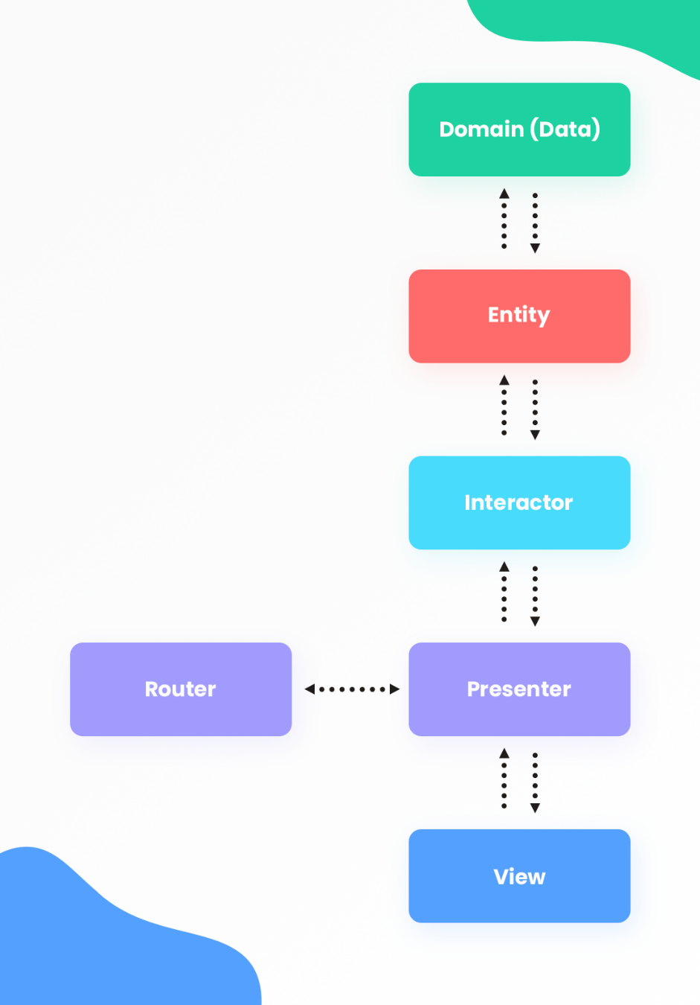
App-level architecture
Maintainability
  Separation of concerns
  Dependency inversion
Conway’s Law
Complexity
Testability

Slide 4
MVC
Model
  Data
  Business logic
  Validation
Controller
  Handle user input
  Coordinate application behavior
View
  Display data
  Forward user interaction
Notes:
Controller handles user input and coordinates interactions between View and Model
Model: Application data and domain logic
View: Displays information to user
Controller: Interprets user actions and coordinates application behavior

Slide 5
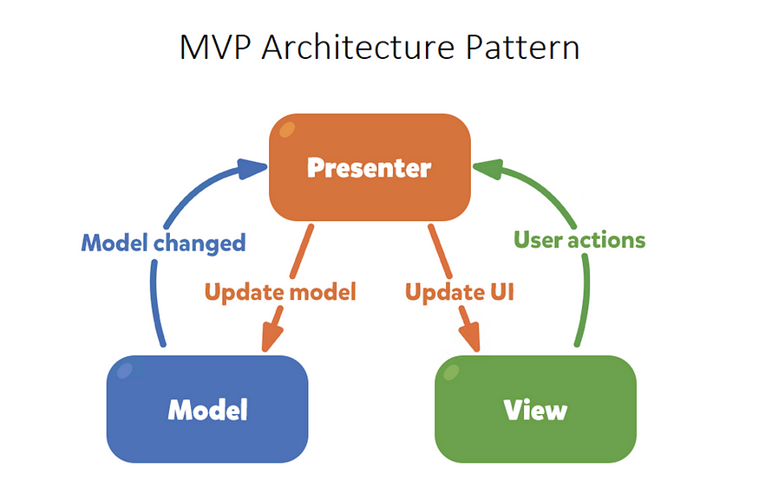
MVP
Presenter – The director
  Handles presentation logic
  Updates views explicitly
  Typically communicates through an interface
Model = MVC-model
View = MVC-view
  But communicates with Model through presenter
Notes:
Presenter manages presentation logic and instructs View what to display

Slide 6
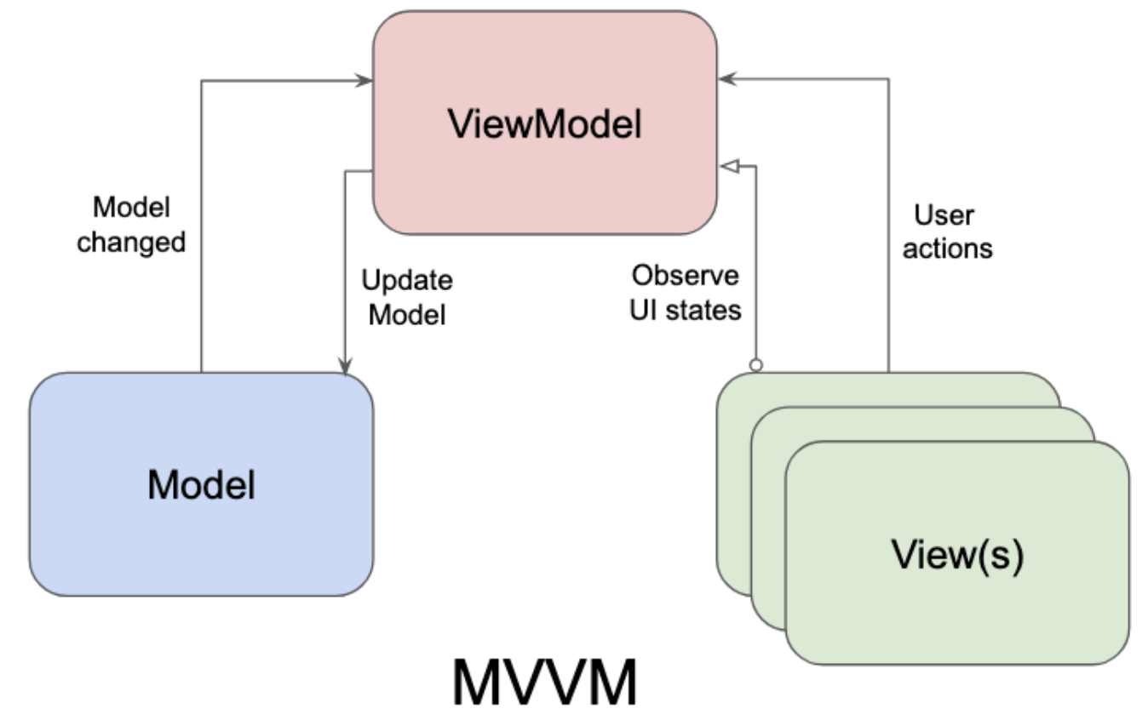
MVVM
Model
  Data and business logic
View
  Observes ViewModel state
  Forwards user interactions
ViewModel
  UI state and presentation logic
  Independent of View implementation
Observable UI state
  View automatically reacts to state changes
  Works naturally with Jetpack Compose

Slide 7
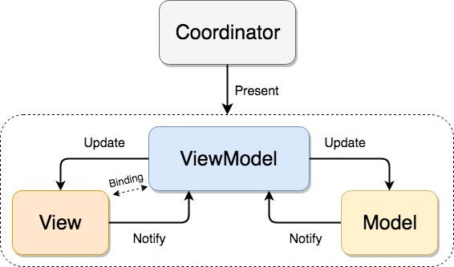
MVVM-C = MVVM + Coordinator
Notes:
Coordinator is responsible for navigation and coordinating flows between screens
Instead of having individual screens or VMs manage the responsibilities

Slide 8
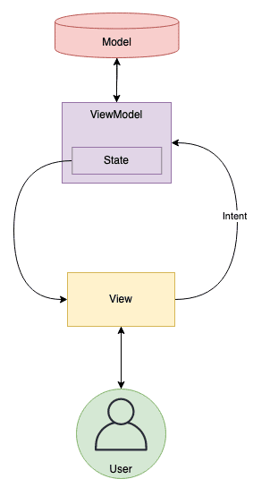
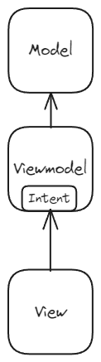
MVI
Model
  Current UI state
  Typically immutable
Intent
  Actions from View → ViewModel
  Processed into new state
View
  Sends intents
  Renders current state
New State
Notes:
Groups state into one object rather than multiple independent state variables
Makes state transitions explicit and predictable

Slide 9
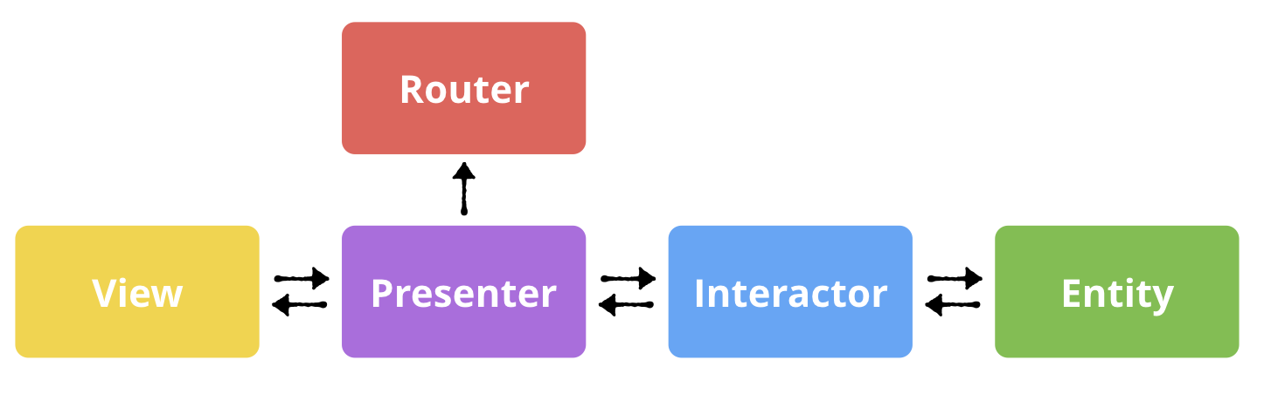
VIPER
View: Displays UI and forwards user interactions to presenter
Interactor: Business logic and use cases, communicates with repositories
Presenter: Handles presentation logic, coordinates View and Interactor and updates View
Entity: Data Models
Router: Handles navigation between screens

Slide 10
ARCHITECTURE COMPARISON
Architecture | Advantages | Disadvantages
MVC | Simple Relatively few components | Controllers can become large Potentially tight coupling
MVP | Testable presentation logic Explicit View interactions | View interfaces and boilerplate Manual UI updates
MVVM | Observable UI state Good testability | State management can become complex VMs can grow large
MVI | Predictable state transitions Unidirectional data flow | Additional boilerplate Complex event/state handling
VIPER | Strong SoC Testability | Many components Boilerplate and complexity

Slide 11
Navigation in Jetpack Compose

Slide 12
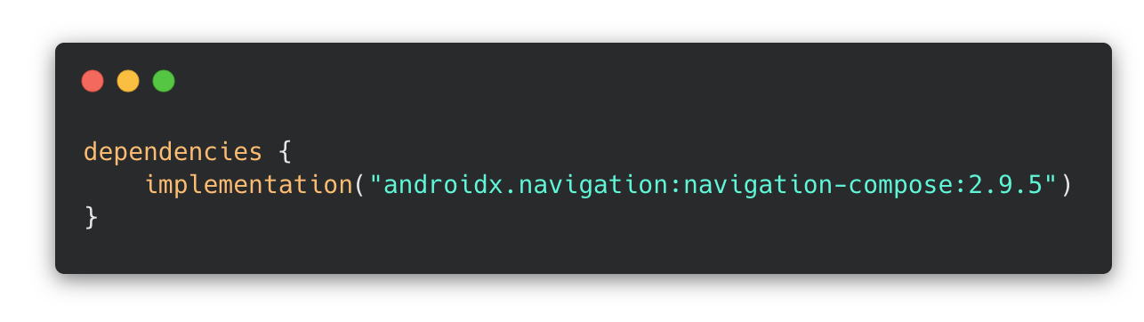
Navigation – Setup
Multiple screens → need to define navigation between them and keep consistent state
To add navigation to your project, add the dependency in your build.gradle.
(Exact version may differ)

Slide 13
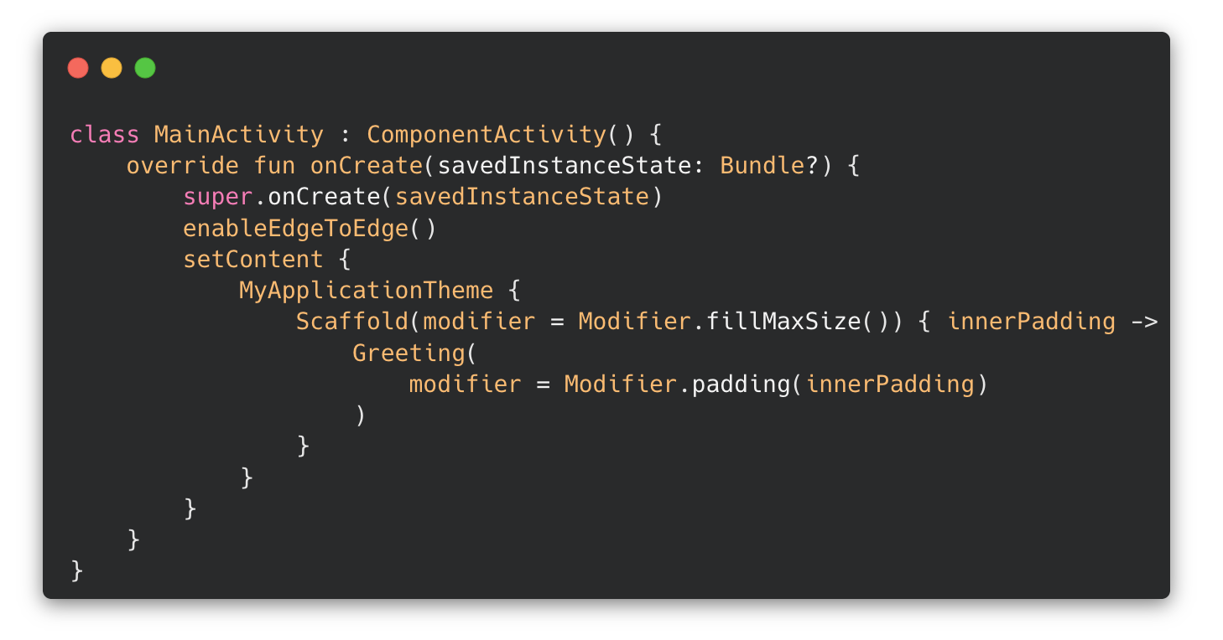
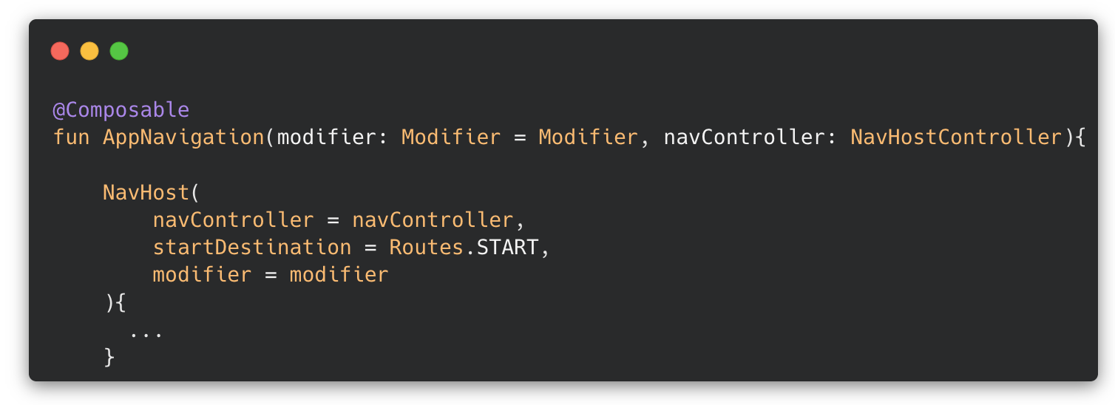
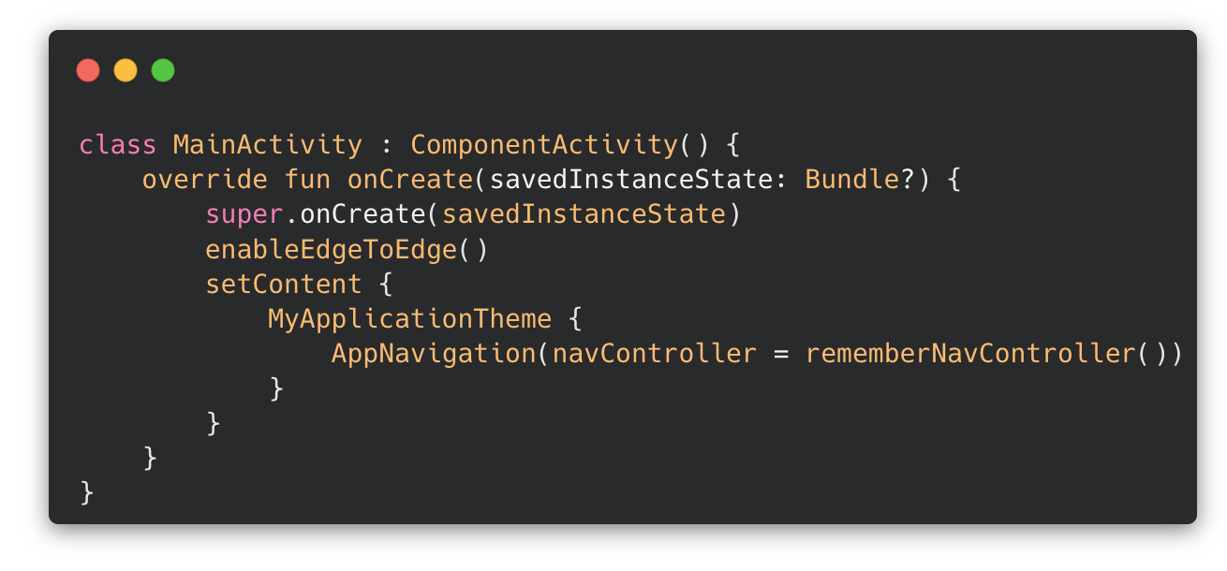
Navigation – Nav Graph
Destinations, their connections and the props passed between them are defined as a navigation graph
To define this, create a composable with a NavHost instance
A container that displays one navigation destination at a time
This composable becomes the root of our app’s UI hierarchy

Slide 14
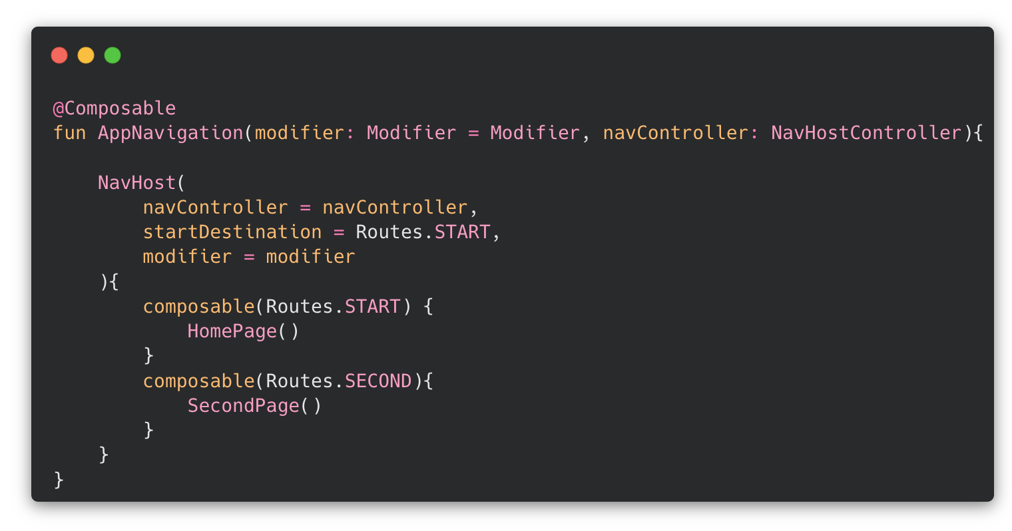
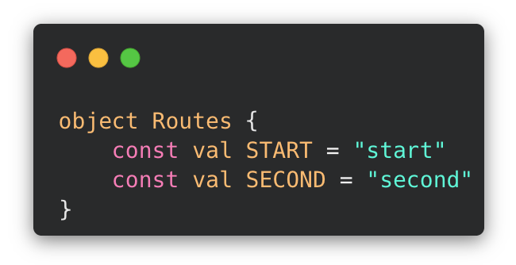
Navigation – Destinations
Destinations are defined using composable()
composable(Routes.START) defines a navigation destination identified by the START route
The route name is simply a string. As in this example, they should be defined centrally instead of raw strings to avoid typos
The content of the destination describes what is shown, when the destination is active

Slide 15
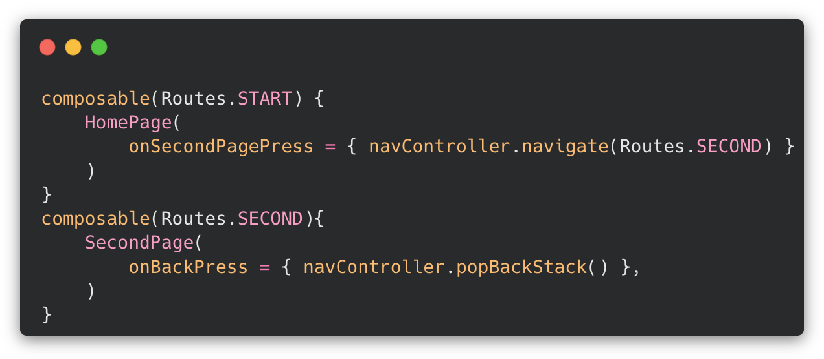
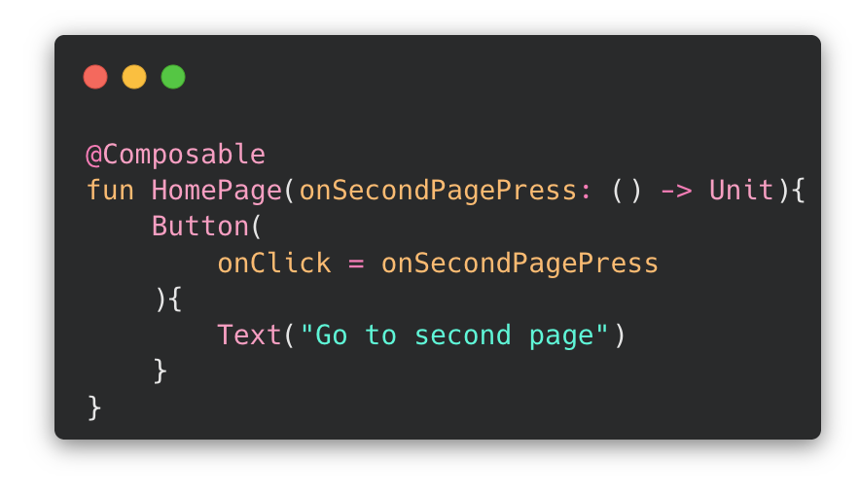
Navigation – Navigating
To navigate between screens, each screen receives callback functions for the different navigation actions they can trigger
In the nav graph, these are connected to the NavController
→ navController.navigate(route) navigates to the specified navigation
The screens should have arguments for each navigation function that are passed along with them

Slide 16
Live Demo

Slide 17
Short Exercise – Part I
Create an application with two or more different screens
Implement navigation between the screens
Bonus: Implement a TopNavBar or BottomAppBar to navigate between the screens
(https://developer.android.com/develop/ui/compose/components/app-bars)

Slide 18
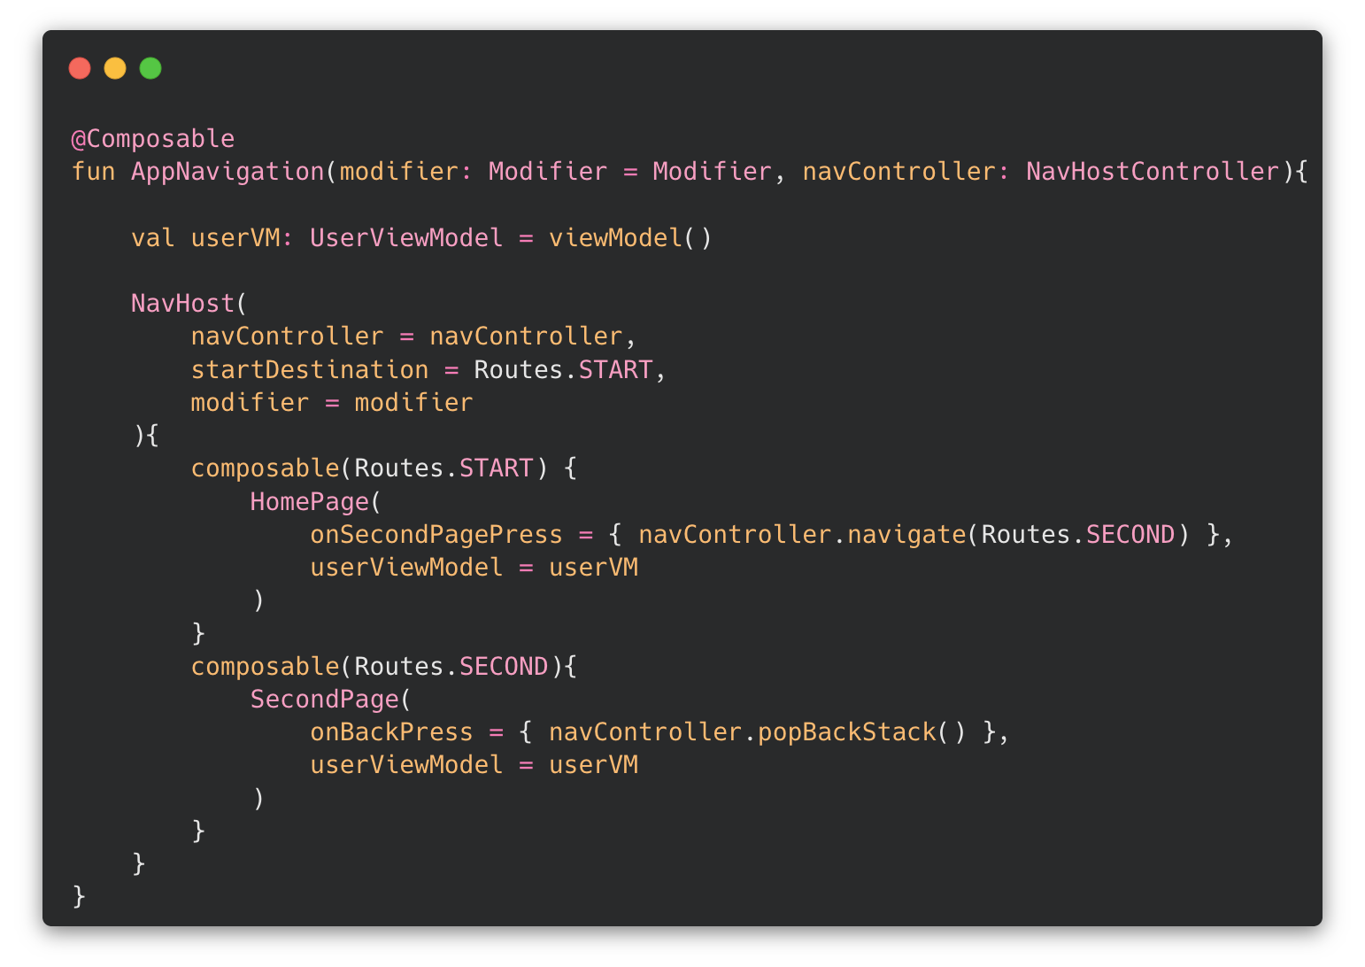
Navigation – Keeping State
Some state needs to be shared across multiple screens
Such as the currently logged-in user
For shared state, create the ViewModel at a shared scope and pass the same instance to the screens that need it.
This ensures that the screens have access to the same state, instead of having separate instances with independent state

Slide 19
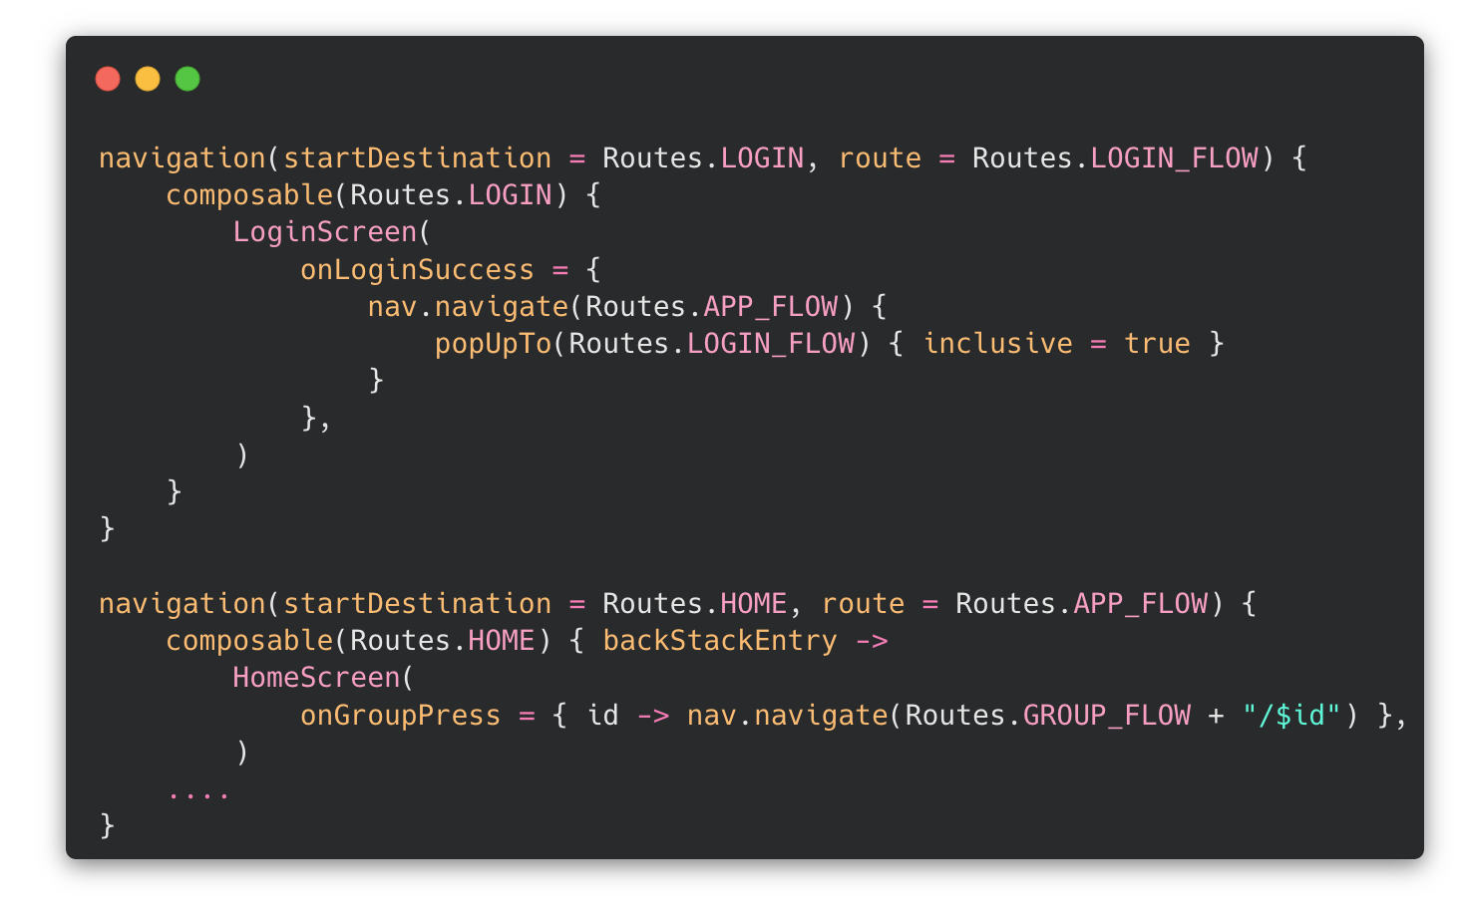
Navigation – Nested Graphs
Related destinations can be grouped into separate flows.
A navigation flow is created using navigation()
Each flow has its own internal destinations and navigation, allowing us to control and limit navigation.
→ Example: we shouldn’t be able to ”swipe back” to the login screen from the home screen.

Slide 20
Live Demo

Slide 21
Short Exercise – Part II
Introduce a shared state between the two screens from previously
Update the screens from the exercise:
  On the first screen: A textfield and a button to enter your name
  On the second screen: Display the name entered on the first screen
Use a shared ViewModel to keep the state across the two screens
  For simplicity, you may also just create a shared variable instead of a ViewModel

Slide 22
Project Work
Implement Navigation in your projects
Continue Project work

